Slide 1
Safe Security Testing on Drupal –Bug Bounty Scope
This project demonstrates safe and ethical security testing on Drupal websites within the Open Bug Bounty program scope. All testing was performed only on my own account or authorized targets, ensuring no harm to the system or other users.
The project evaluates common web vulnerabilities, including Cross-Site Scripting (XSS), Cross-Site Request Forgery (CSRF), Open Redirect, and Access Control, using professional scanning tools and verification techniques.
Documentation includes screenshots and detailed observations, highlighting the security measures implemented by Drupal.

Slide 2
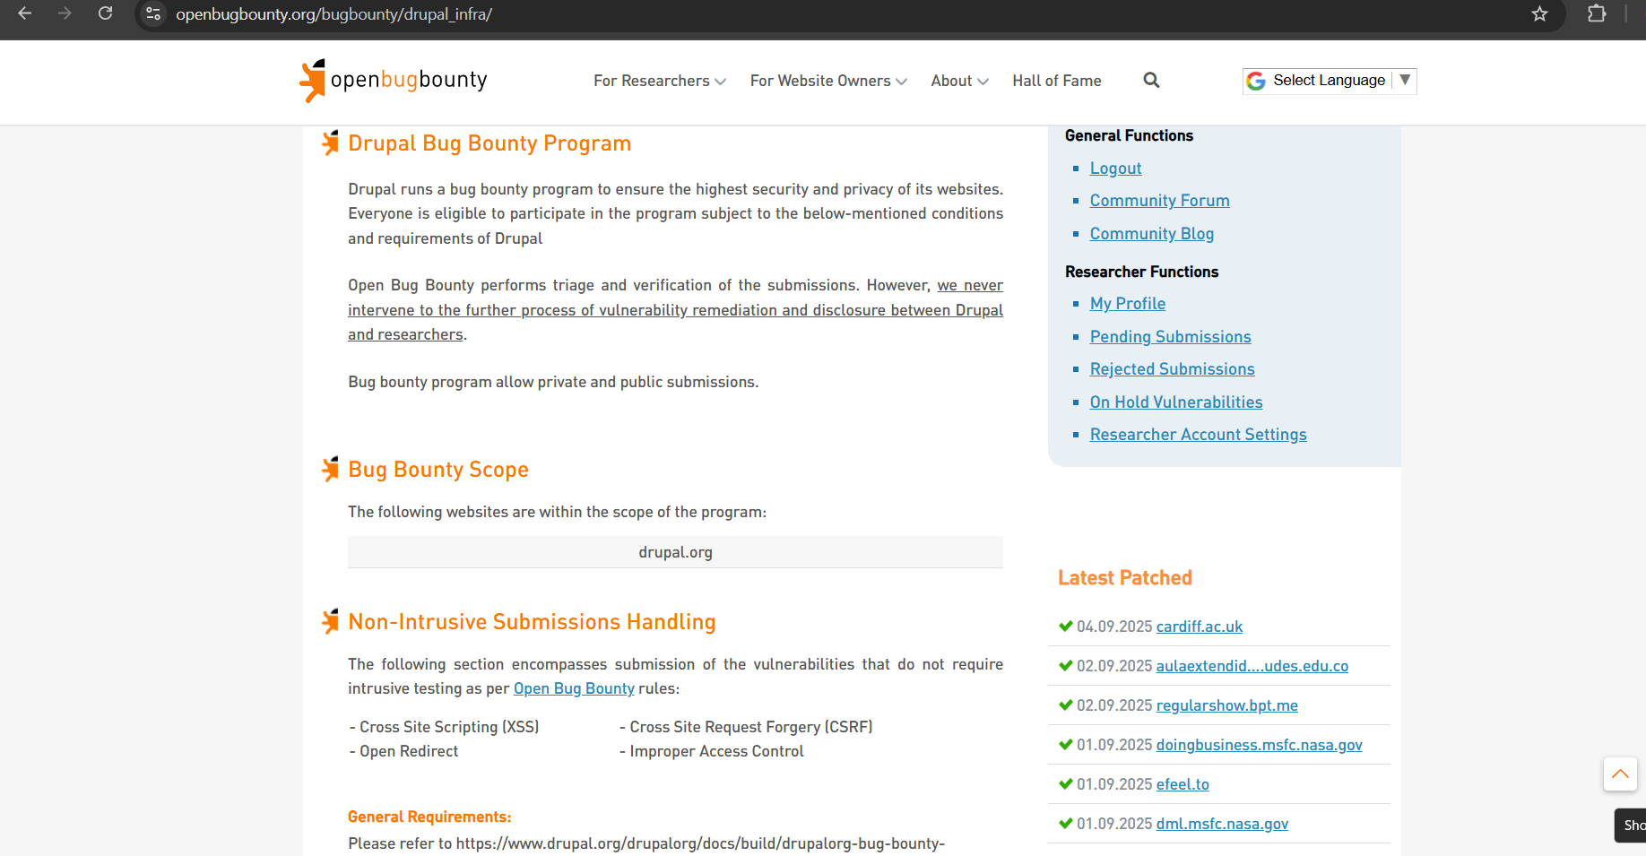
Pick the Openbugbounty listed test website Drupal

Slide 3
Use WhatWeb to detection of CMS and underlying technologies

Slide 4
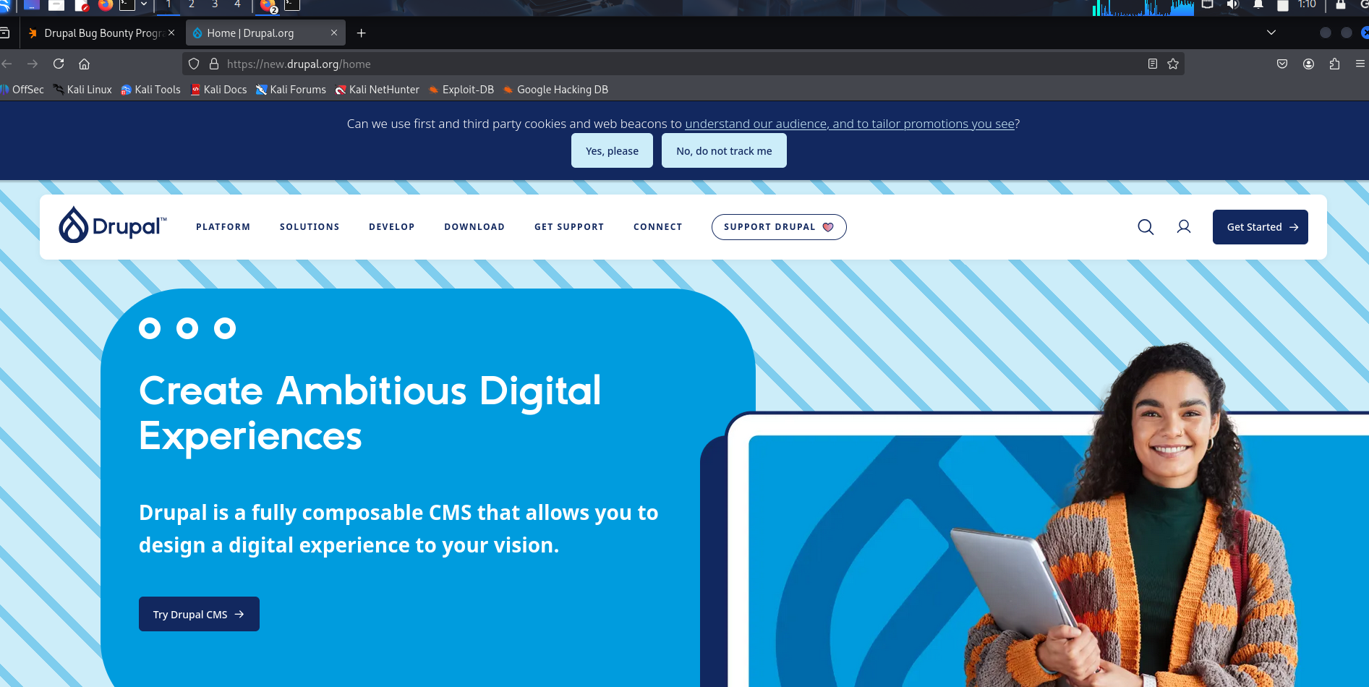
See in browser it display home page of Drupal

Slide 5
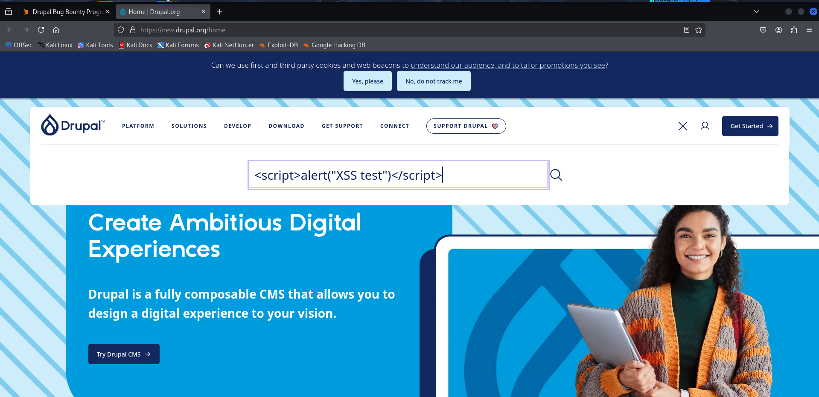
Try XSS Attack tested on harmless input field

Slide 6
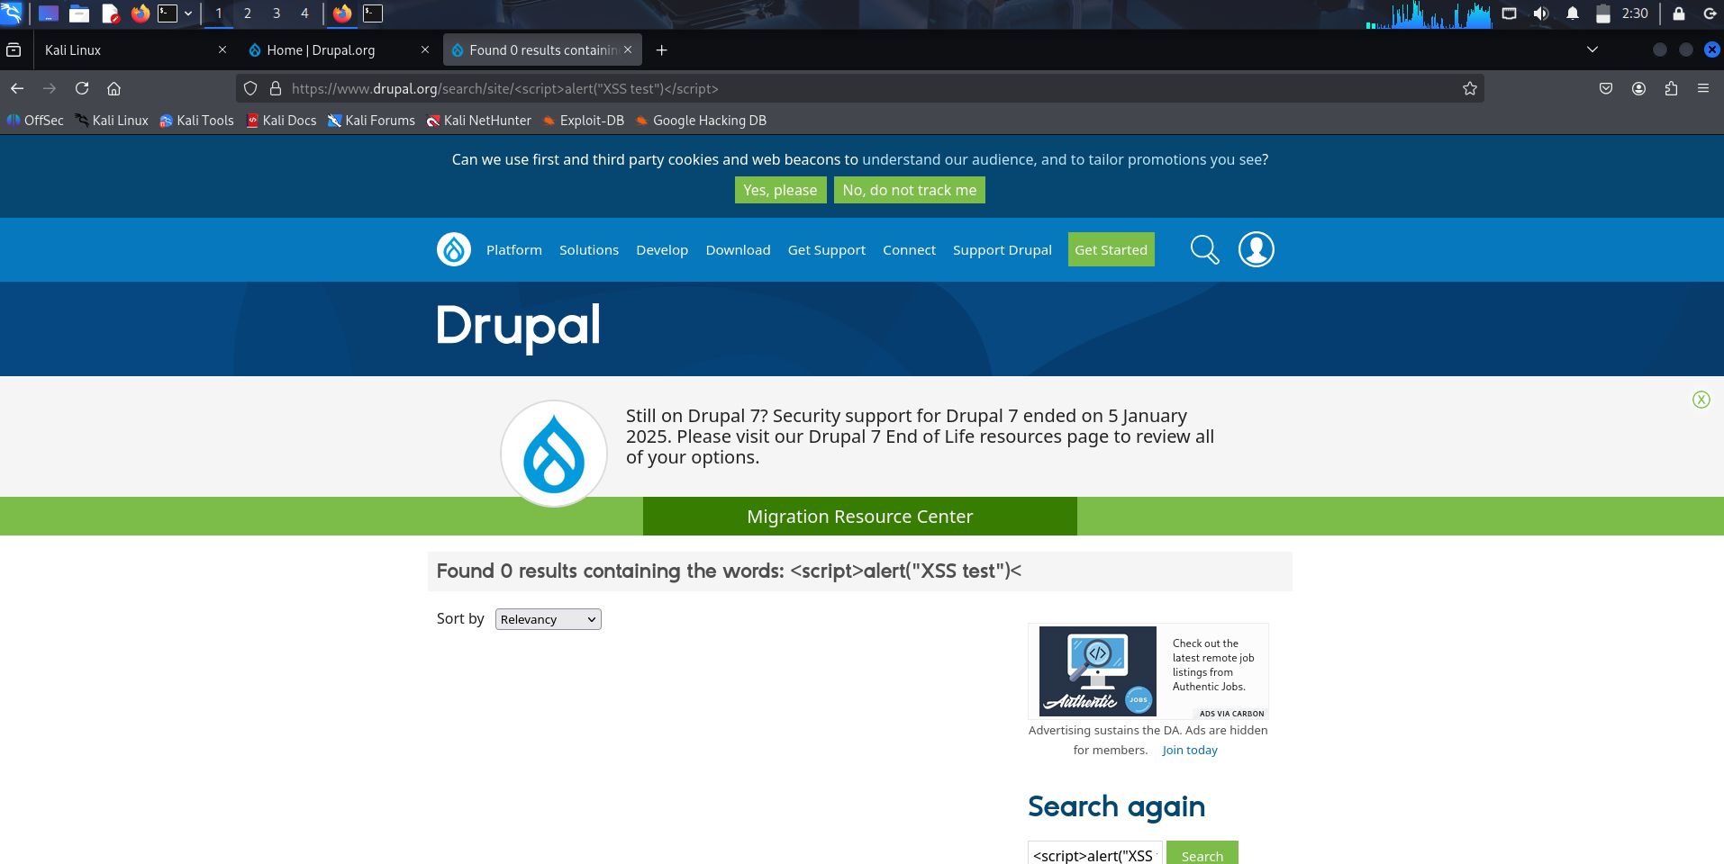
Its not work and display text no execution occurred it seems Drupal secure protection

Slide 7
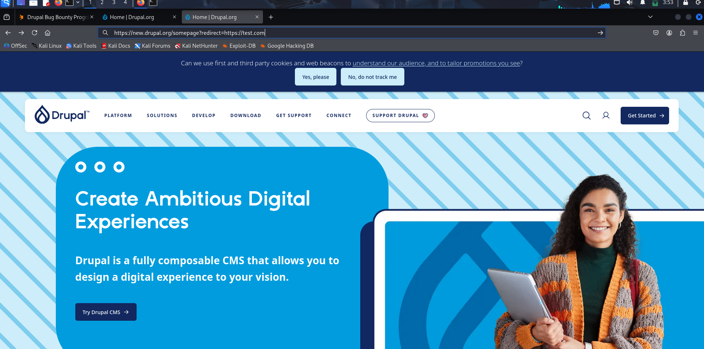
Next , Implement Open Redirect Attack(Harmless redirect testing)

Slide 8
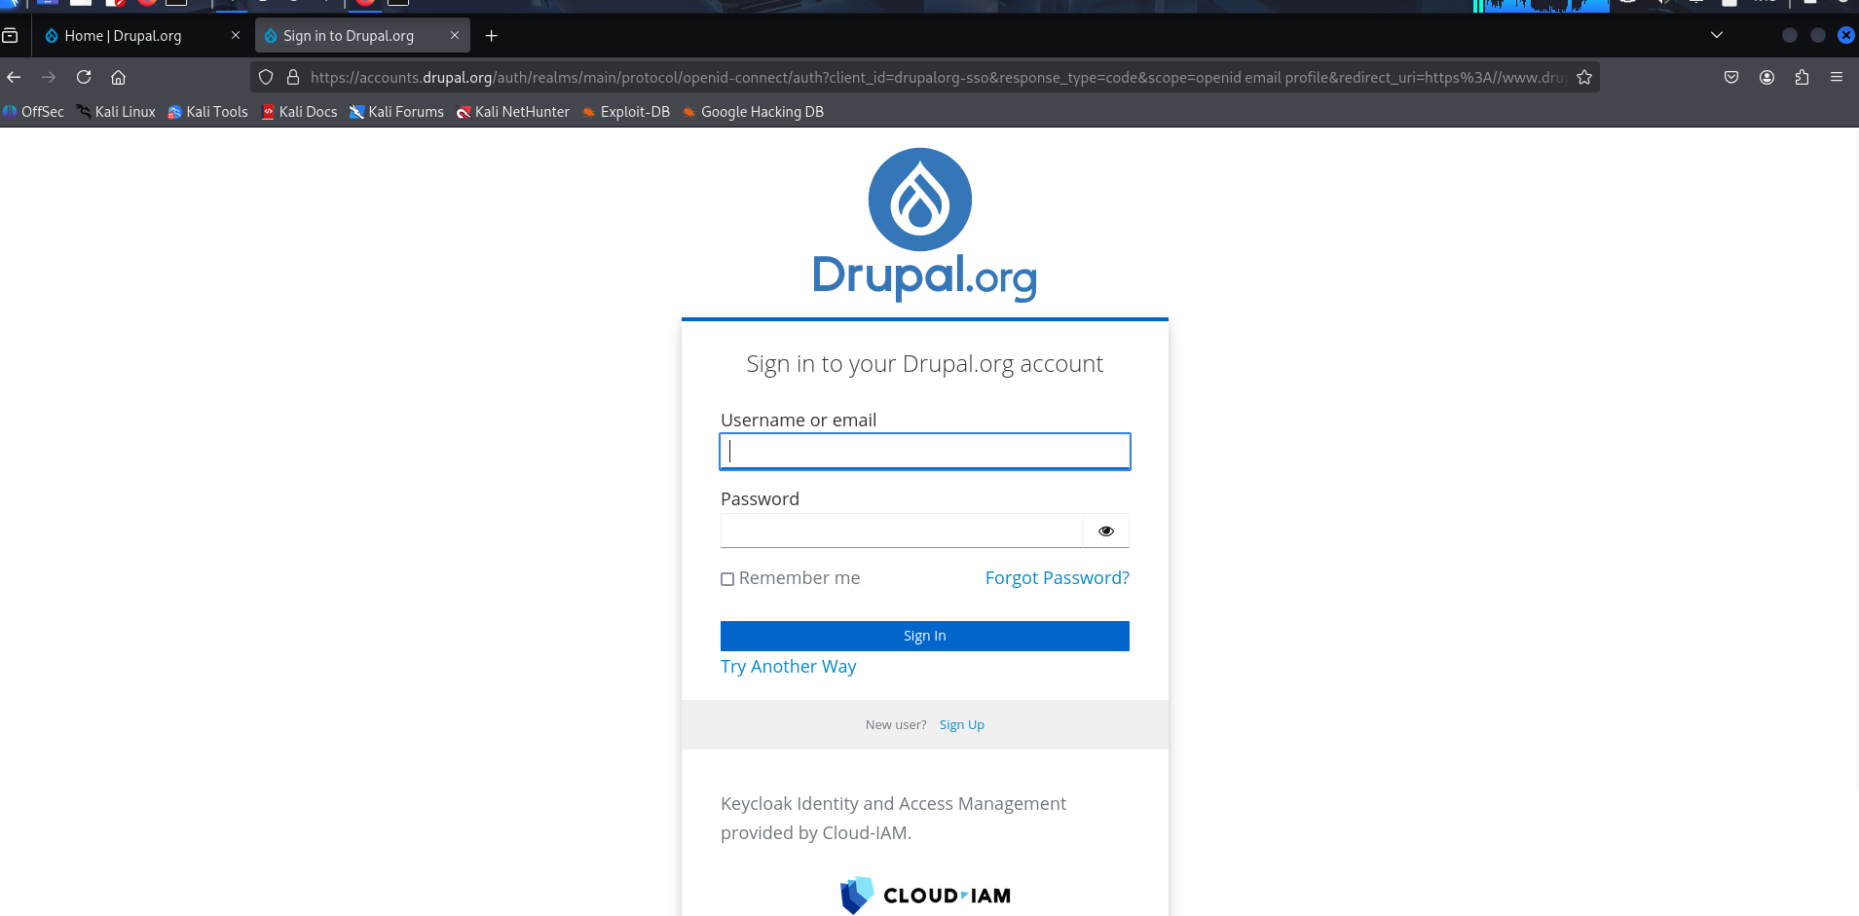
Its not work, Drupal blocked unauthorized redirects(redirect to signup page)

Slide 9
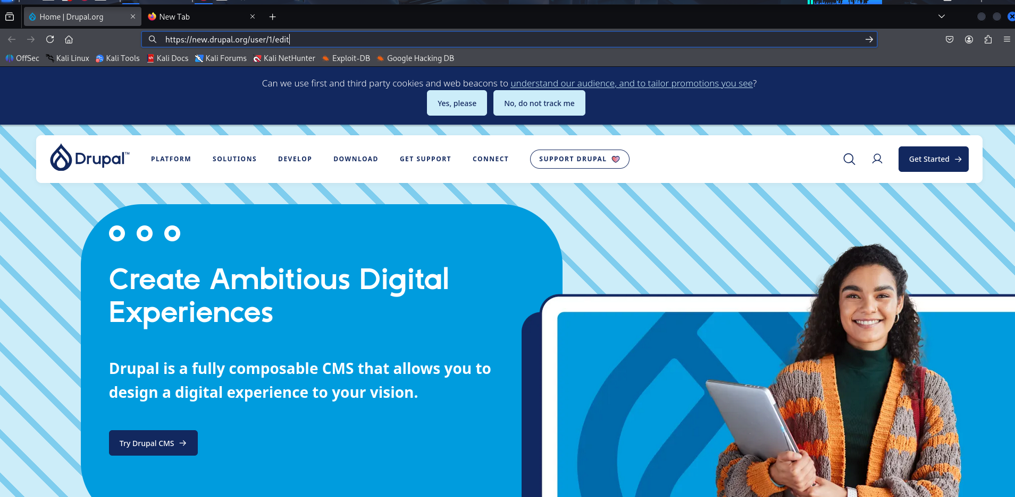
Next, Improper Access Control Attack(Verified user permissions on non-admin forms)

Slide 10
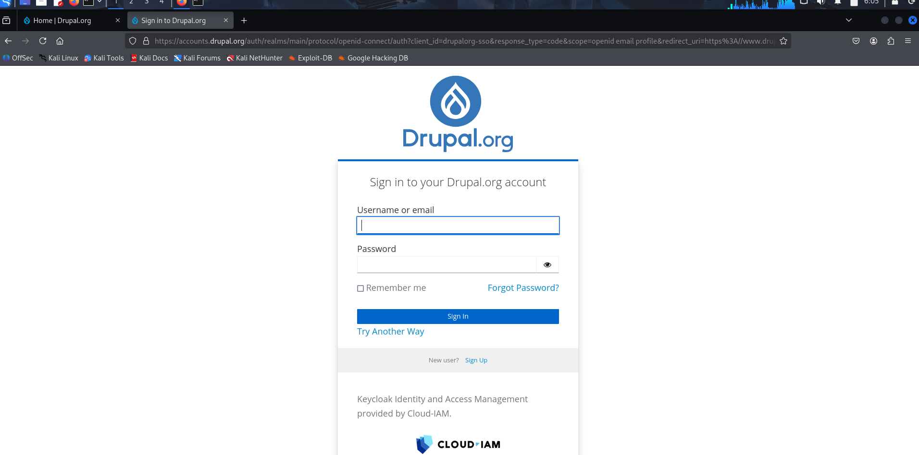
It displays signup page access was properly restricted

Slide 11
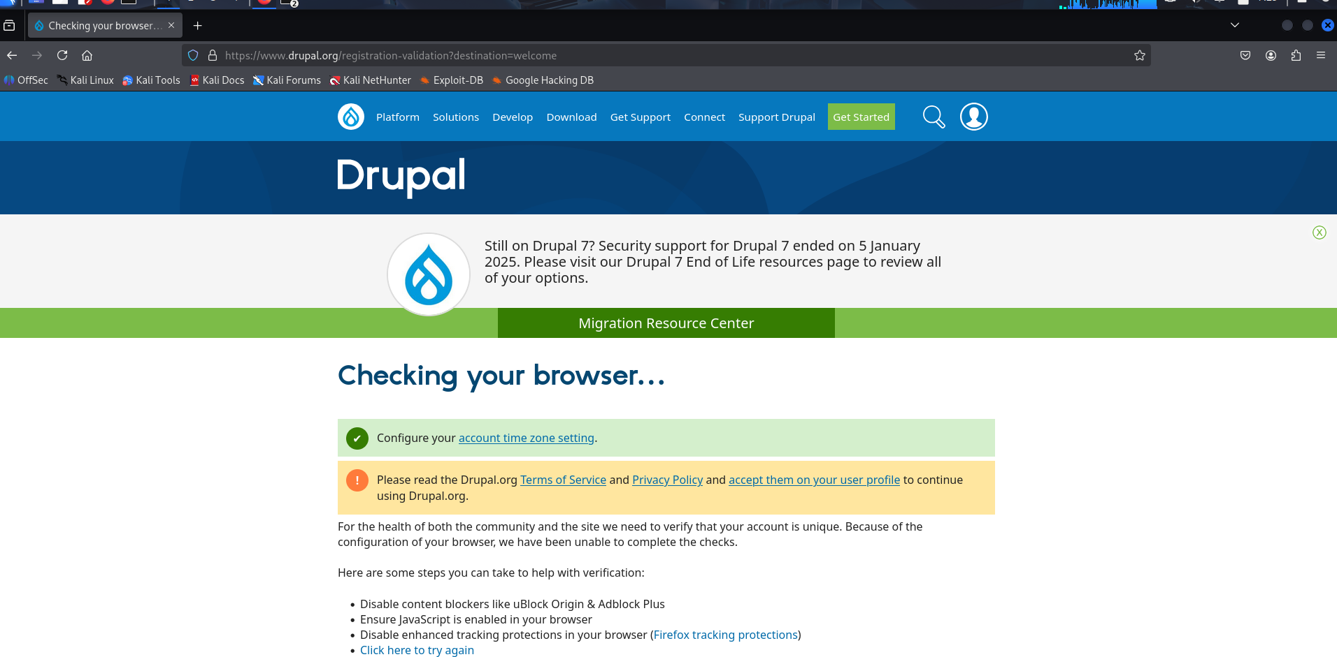
Login the Drupal website for CSRF Attack

Slide 12
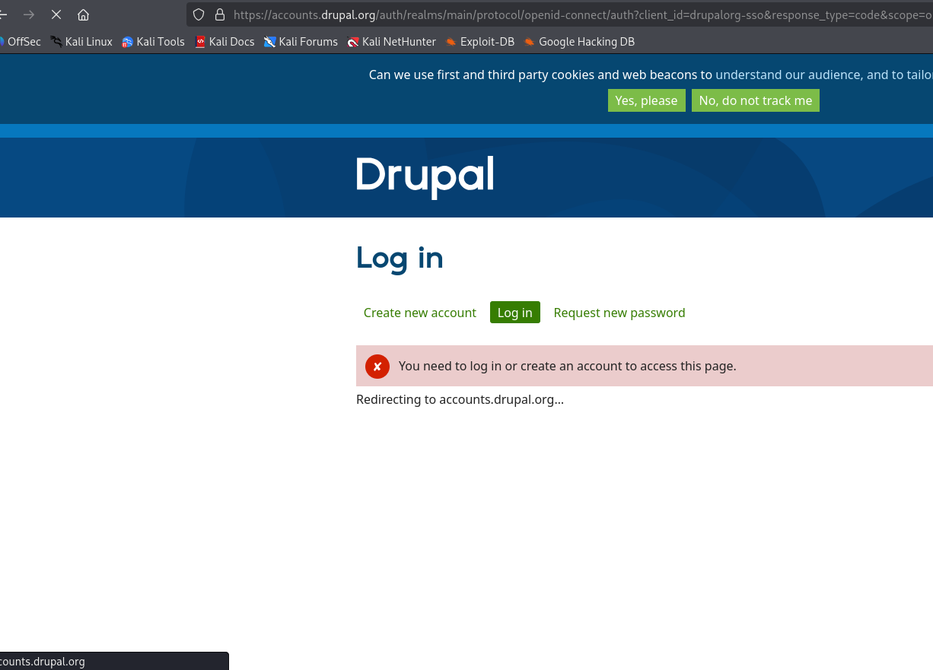
Redirecting to login page

Slide 13
Conclusion:
This project evaluated selected Drupal security mechanisms against common web vulnerabilities within the authorized testing scope.
Tests Performed
Cross-Site Scripting (XSS): Tested harmless input fields; no script execution was observed.
Cross-Site Request Forgery (CSRF): Examined form-token protections and observed that submissions without the required token or while logged out were blocked.
Open Redirect: Tested redirect behavior; unauthorized redirection was not observed in the tested cases.
Access Control: Checked permissions on selected non-admin forms; access restrictions were observed.
Results
No successful exploitation was observed during the tests performed.
The findings apply only to the specific test cases and environment examined.
Testing was conducted within the authorized scope and applicable program rules.
Final Remarks
These results do not establish the overall security of Drupal or the entire website. Further authorized testing would be needed to evaluate additional vulnerabilities and security controls.

